Slide 1
Summary of TARGET AML analysis
Feb 21st 2014
Yishai Shimoni
Jing He
Andrea Califano

Slide 2
MRs of Pediatric AML relapse
214 Samples
214 Affymetrix gene ST 1.0 array
16 WXS (pre-post-normal)
WGS are at diagnosis only and we did not use them
FAB Classification:
8 AML subclasses with diverse etiology and prognosis
Risk classification
3 risk groups based on cytogenic abnormalities

Slide 3
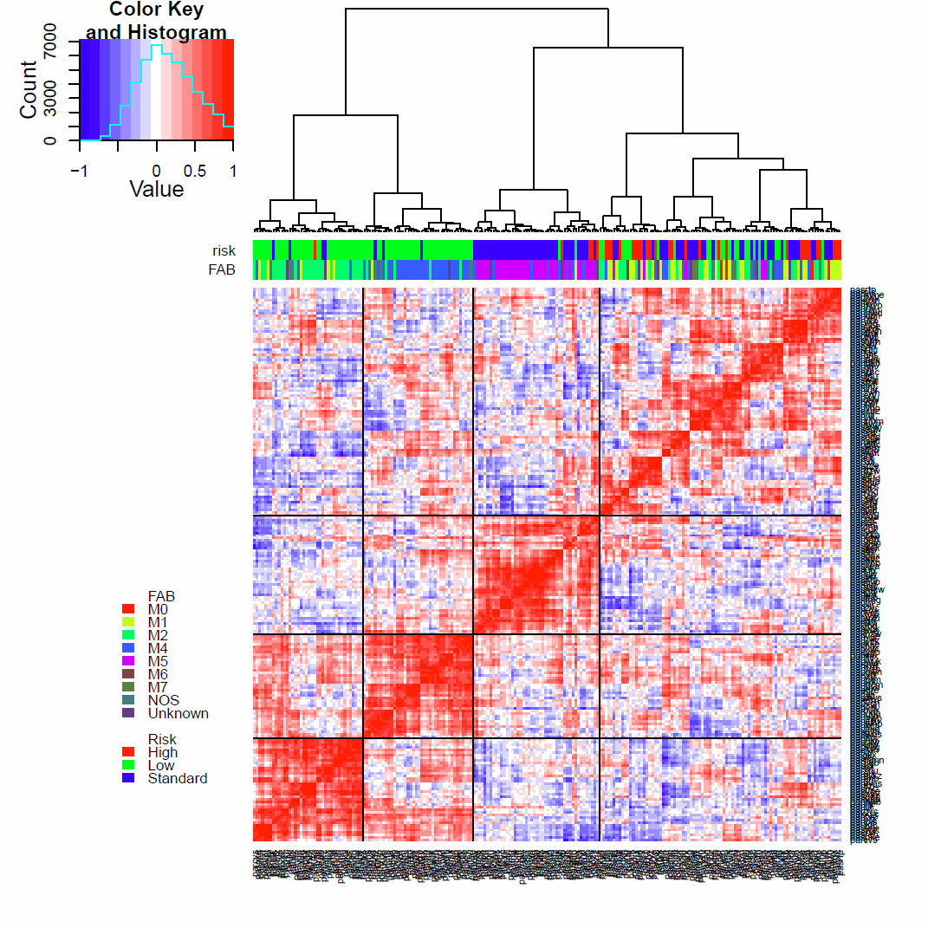
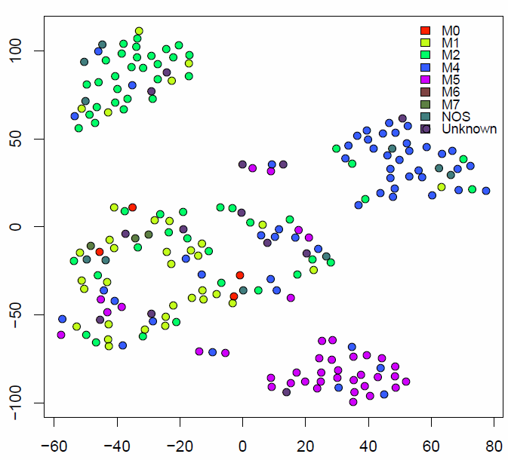
Unsupervised clustering in agreement with FAB classes
M2
M4
M5
Mixed
New classes also account for the risk

Slide 4
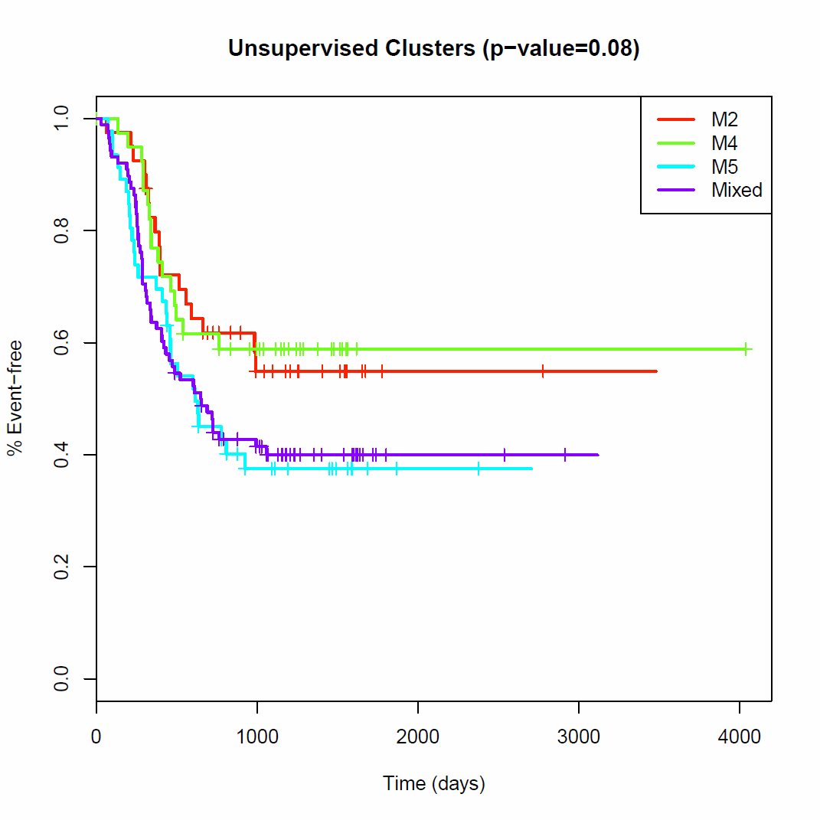
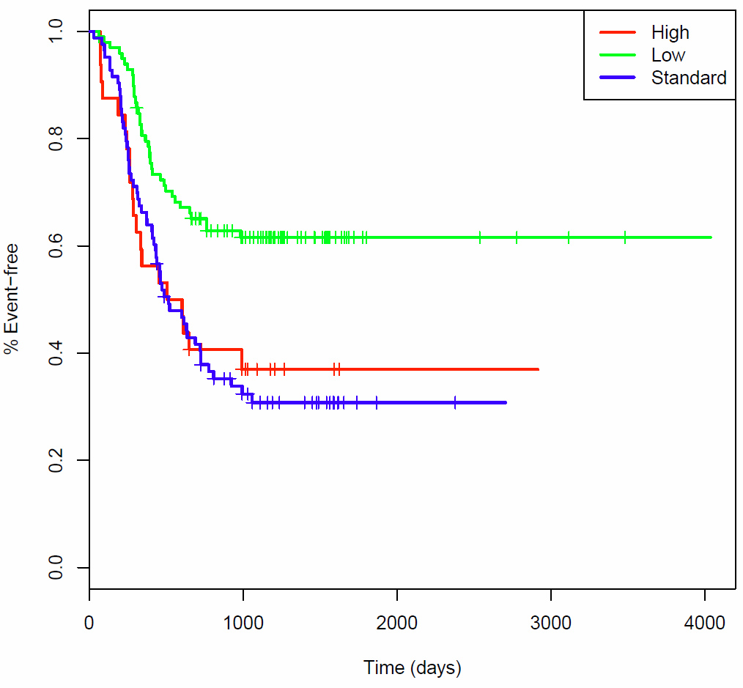
Defined clusters separate survival
Risk Group (p-value 2E-4)
Late censored
> 1060 days
Late censored
> 1060 days

Slide 5
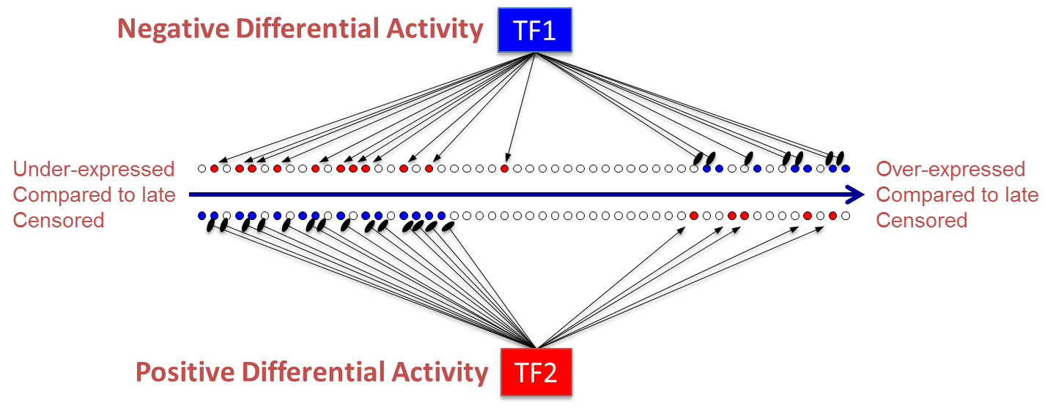
Differential virtual proteomics (VIPER) compared to late censored patients
Regulatory network derived using ARACNe
Each patient is compared to the late-censored in it own subclass

Slide 6
Choosing genes for validation
Genes that appear at the top in more than one subclass
Technically - genes that were chosen in the top 20 in one subclass but are also ranked in the top 30 in another class
Add genes that appear in only one subclass but are very significant
This resulted in 18 genes
WISP2 | RAB5A | MBIP
ZBTB47 | ZNF131 | RPL7
CLU | TRIAP1 | YBX1
TDP2 | PLAA | ZFAND1
ZNF800 | RNF138 | ZC3H15
RPS6KB1 | SMAD5 | CAMLG

Slide 7
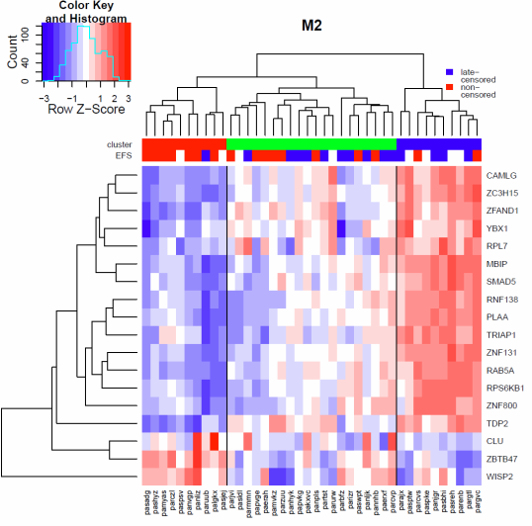
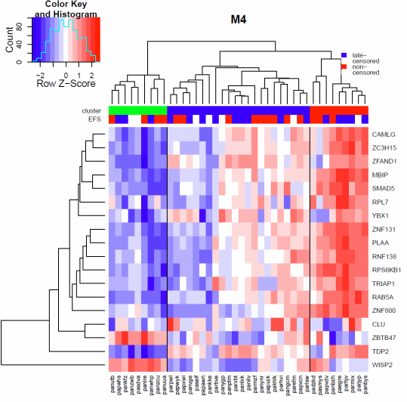
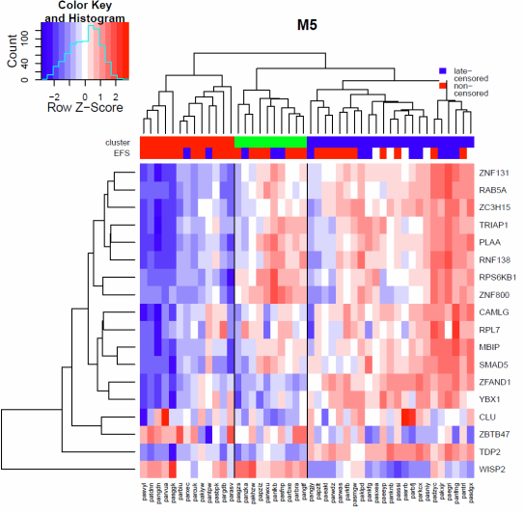
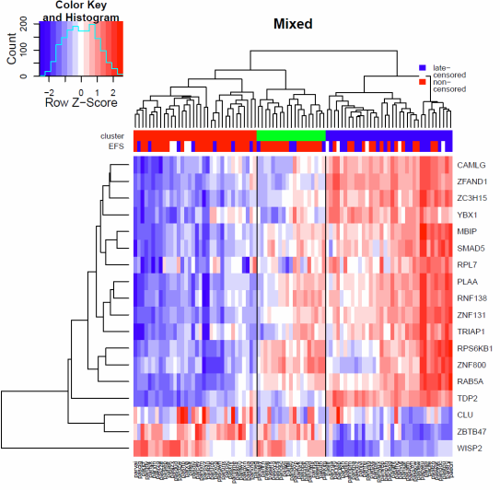
FAB specific relapse prediction

Slide 8
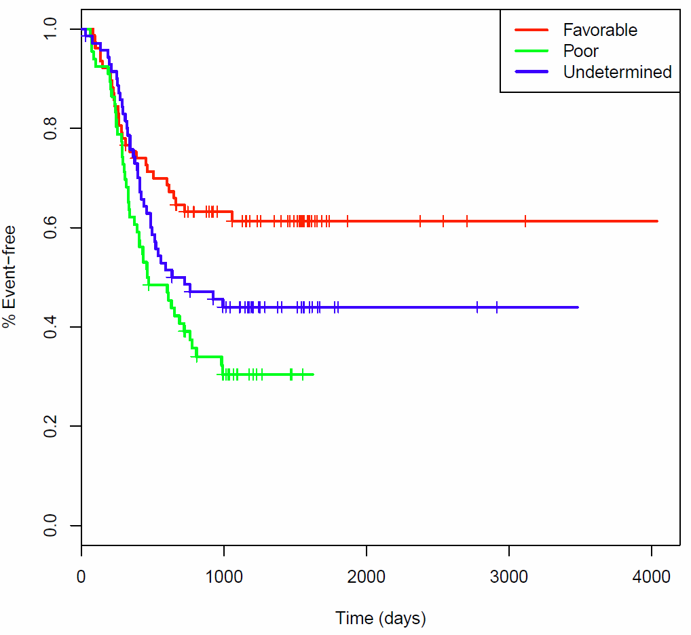
Using the signature we predict favorable, poor, and undetermined risk
Predicted prognosis (p=3e-3)
Risk (p=2e-4)
Individually, risk is still a better predictor

Slide 9
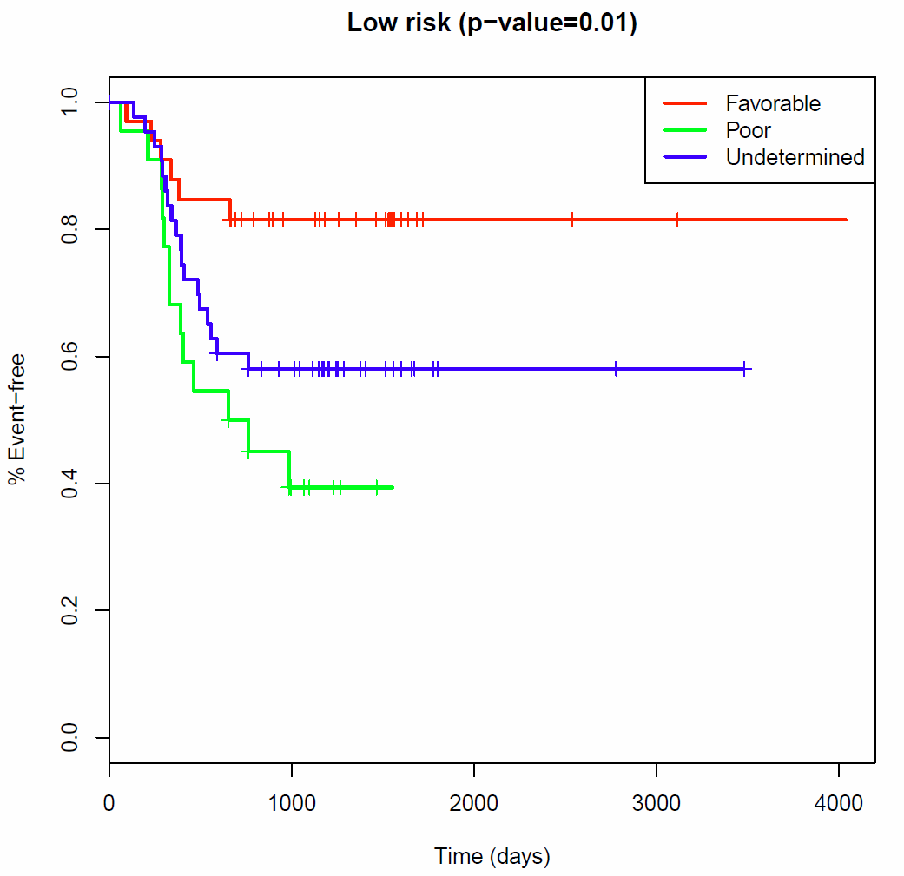
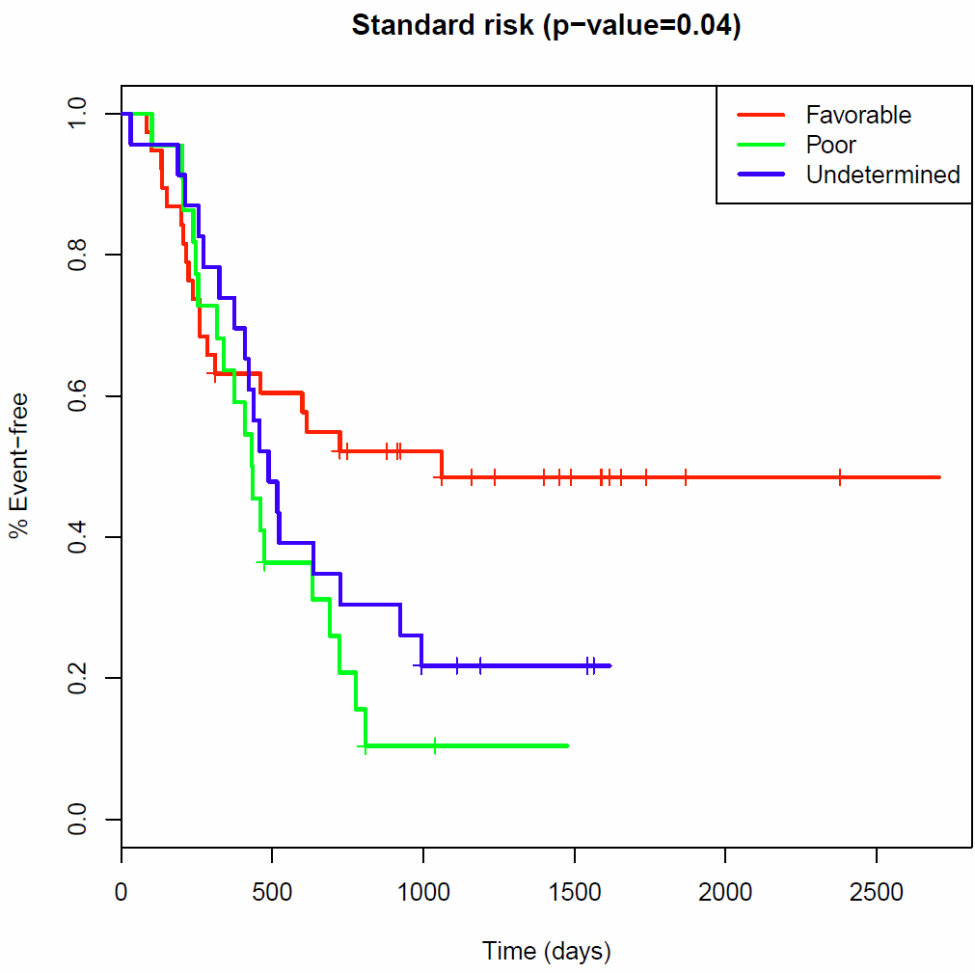
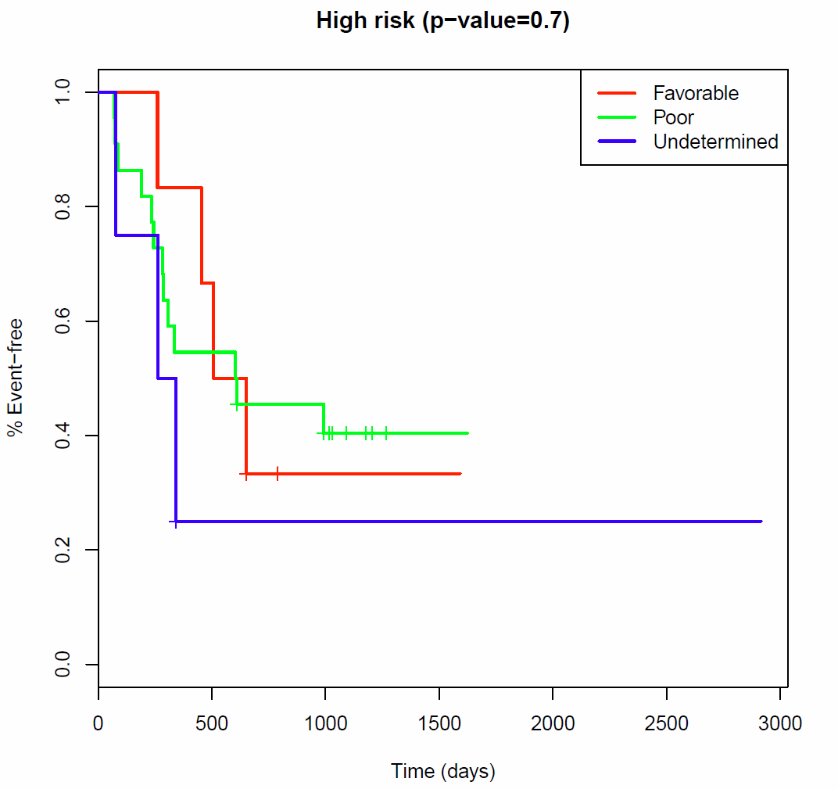
But this is independent information!
Cox model p-values | Risk group (Std. of Care) | Unsupervised clusters | Predicted prognosis | Risk-based predicted prognosis
Risk group | 1.7 E-4
Unsupervised clusters | 3.0 E-3 | 6.7 E-2
Predicted prognosis | 9.8 E-06 | 8.3 E-4 | 3.6 E-3
Risk-based predicted prognosis | 8.9 E-06 | 2.0 E-2 | 2.2 E-2 | 8.5 E-2

Slide 10
MAF comparison between diagnosis and relapse
Highlighted samples were predicted with favorable prognosis
Peripheral blood, but copy-number gain in relapse
Two novel mutations

Slide 11
To do
Collaboration with TARGET Team
Soheil Meshinchi , Cynthia McAllister, Robert Arceci, Julie Gastier-Foster
Creation of ~500 TMAs from pediatric patients + negative and positive controls
Testing the MR-based biomarkers against relapse data

